Slide 1
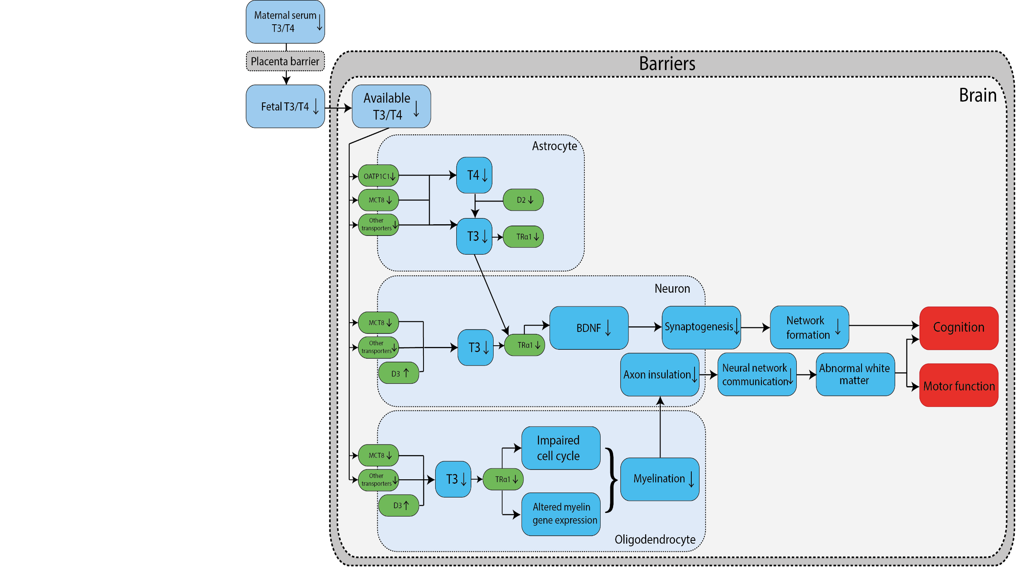
Adverse Outcome Pathway
Dierichs et al. Manuscript submitted

Slide 2


Development of testing battery
Select cell models representing different cell types
Validating cell models
Characterise: uptake, deiodinases, TH receptor activity
Use reference compounds for inhibition
Testing of EDCs

Slide 3

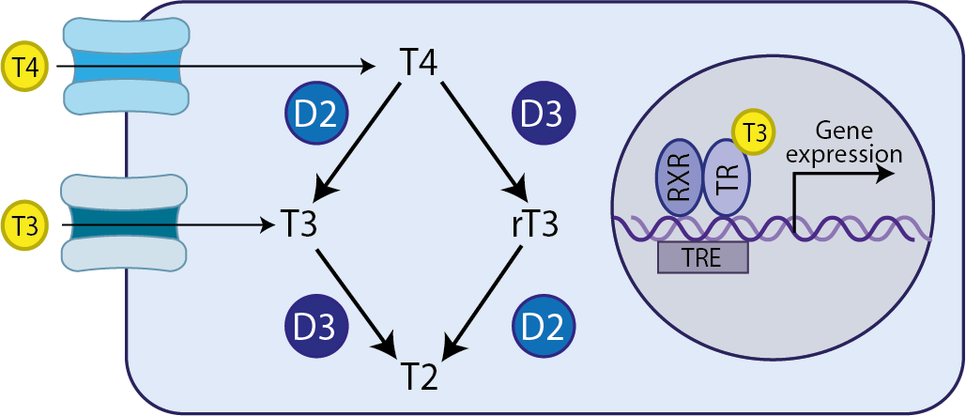
Regulation of TH in target cells
Aim: development of an in vitro testing battery for thyroid hormone mediated developmental neurotoxicity
Astrocytes
Neurons
Oligodendrocytes
TH transport
Deiodination
Receptor activation

Slide 4
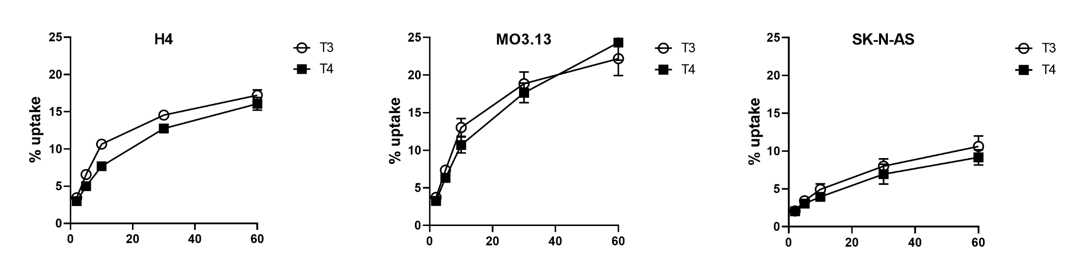
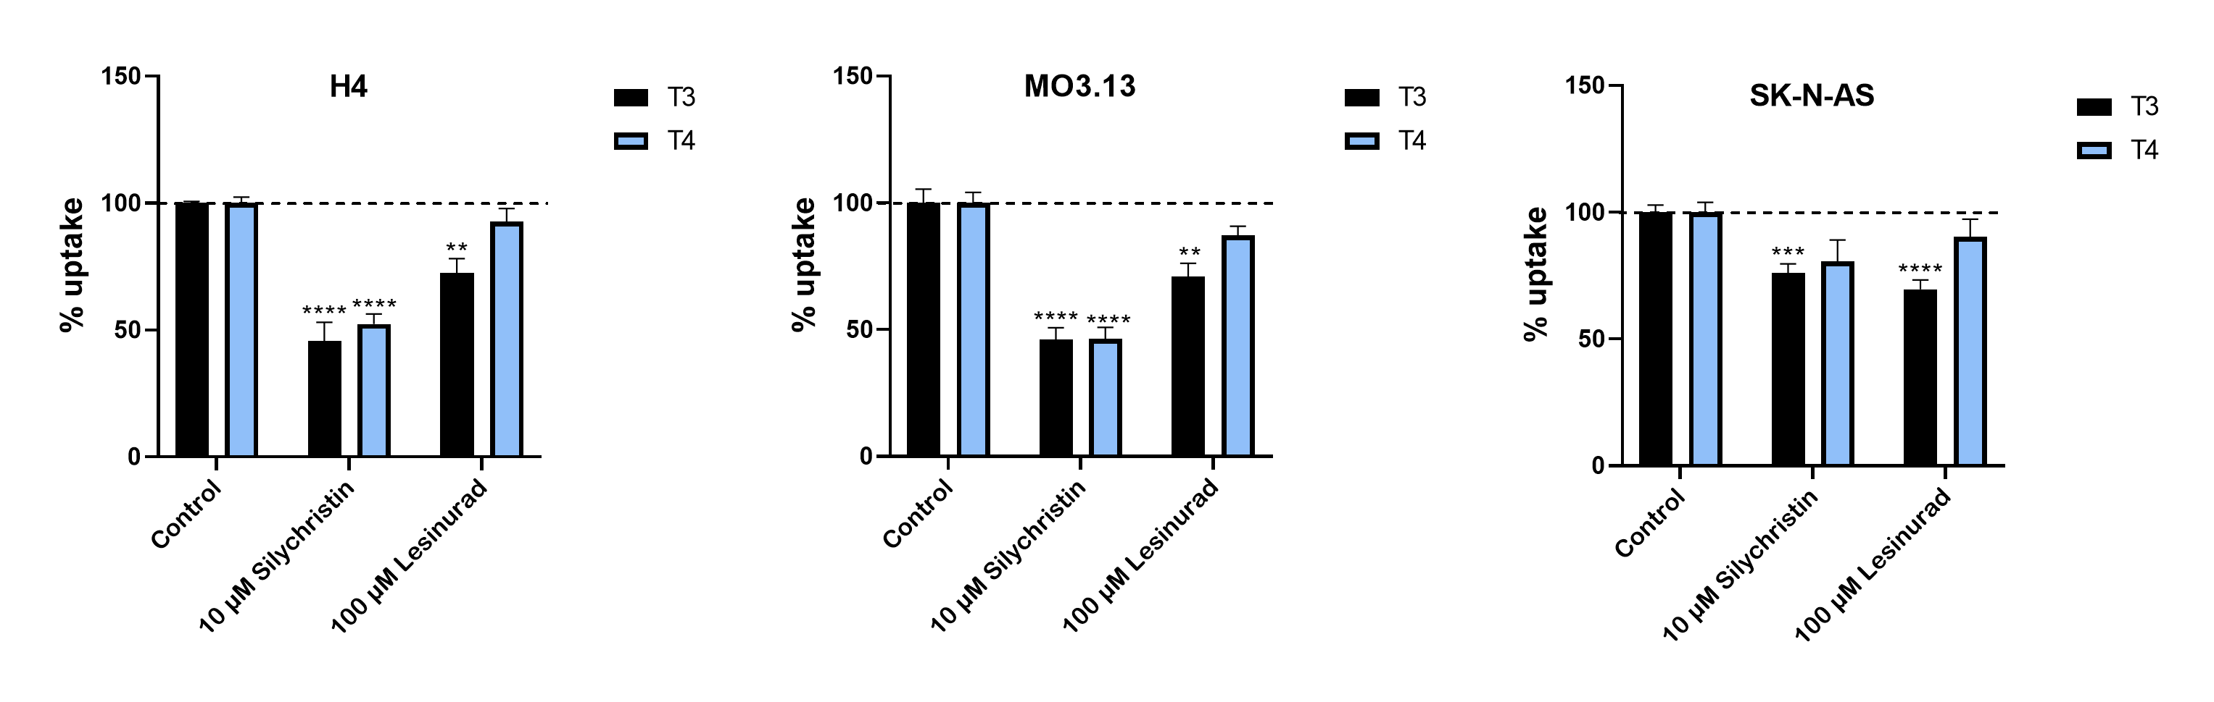
Validation of cell models for TH uptake
N=3 (mean ± SEM)
**p<0.01, ***p<0.001, ****p<0.0001

Slide 5
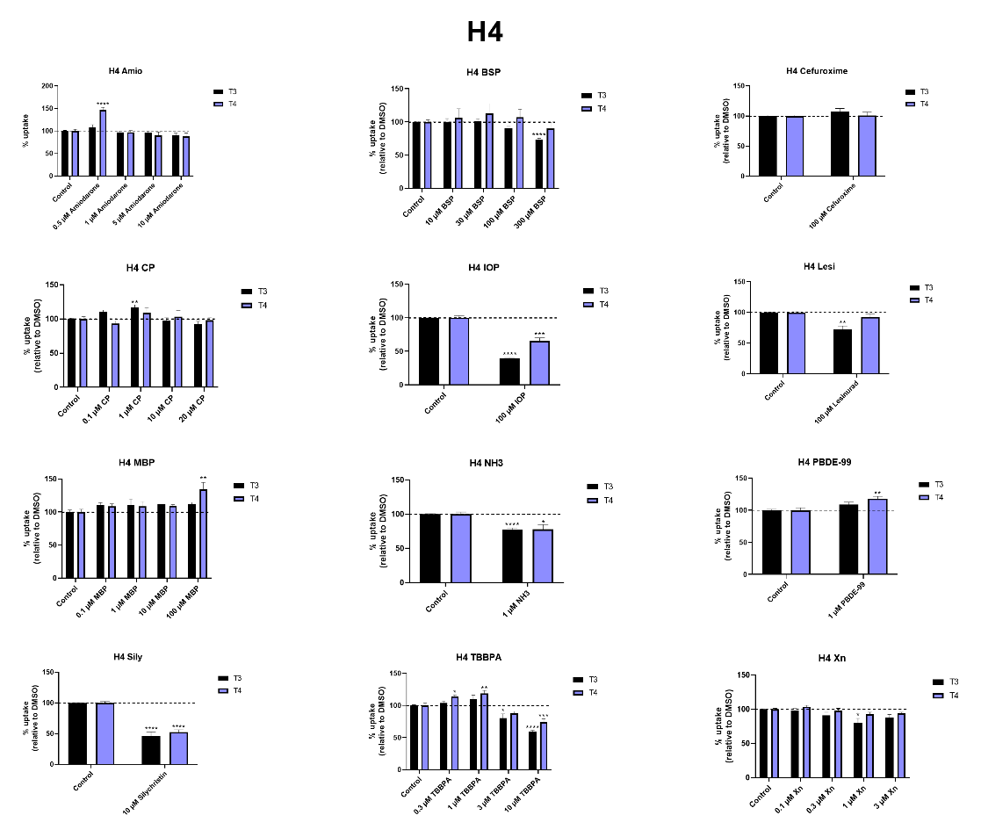
Uptake EDCS H4
N=3 (Mean ± SEM)

Slide 6
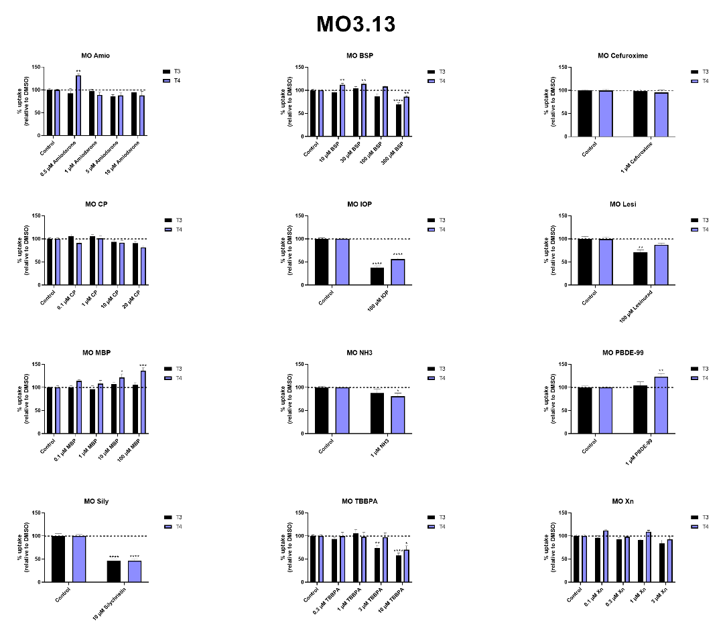
Uptake EDCS MO3.13
N=3 (Mean ± SEM)

Slide 7
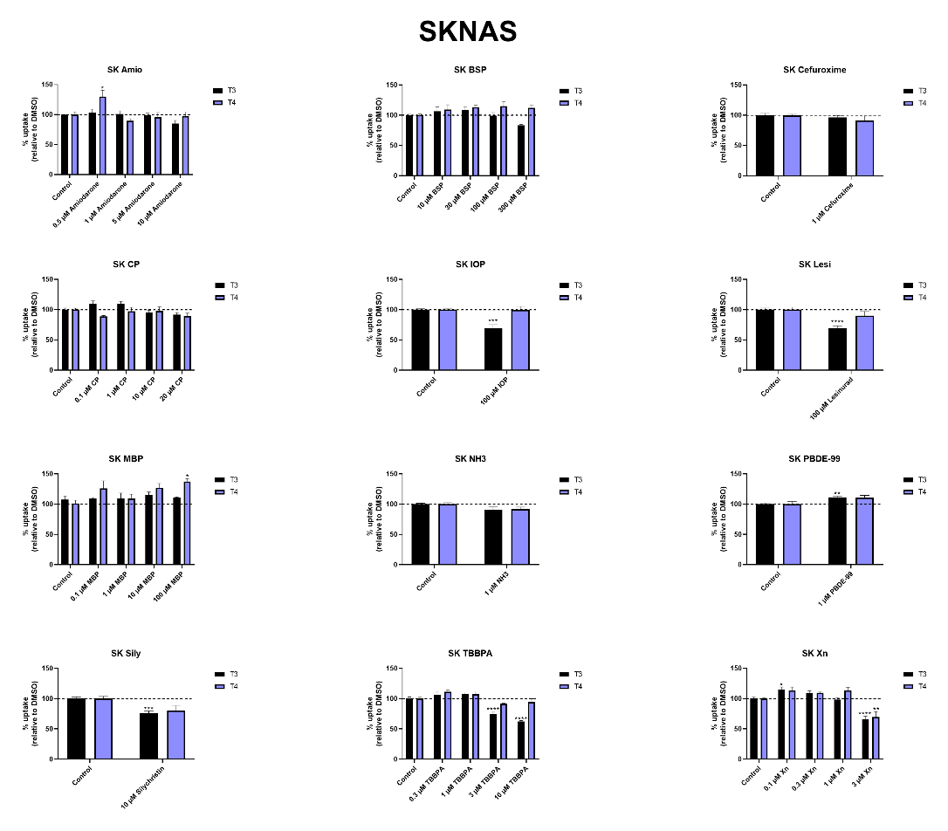
Uptake EDCS SKNAS
N=3 (Mean ± SEM)

Slide 8
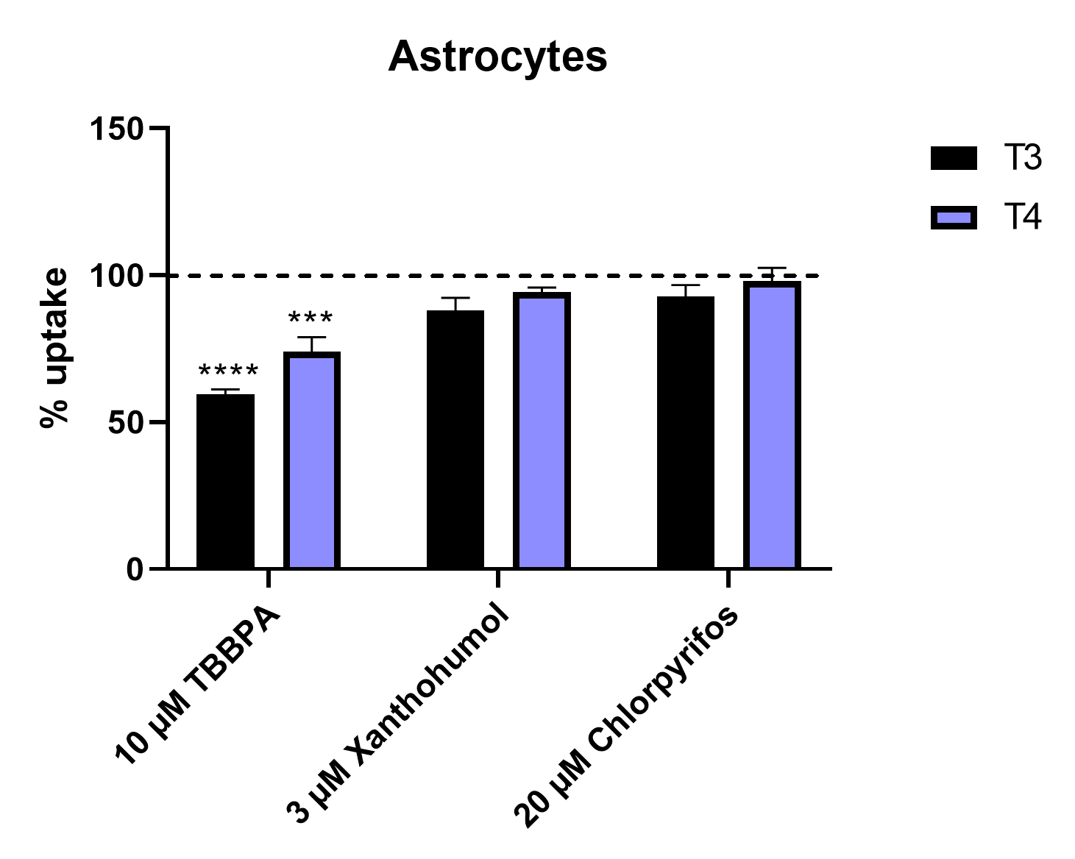
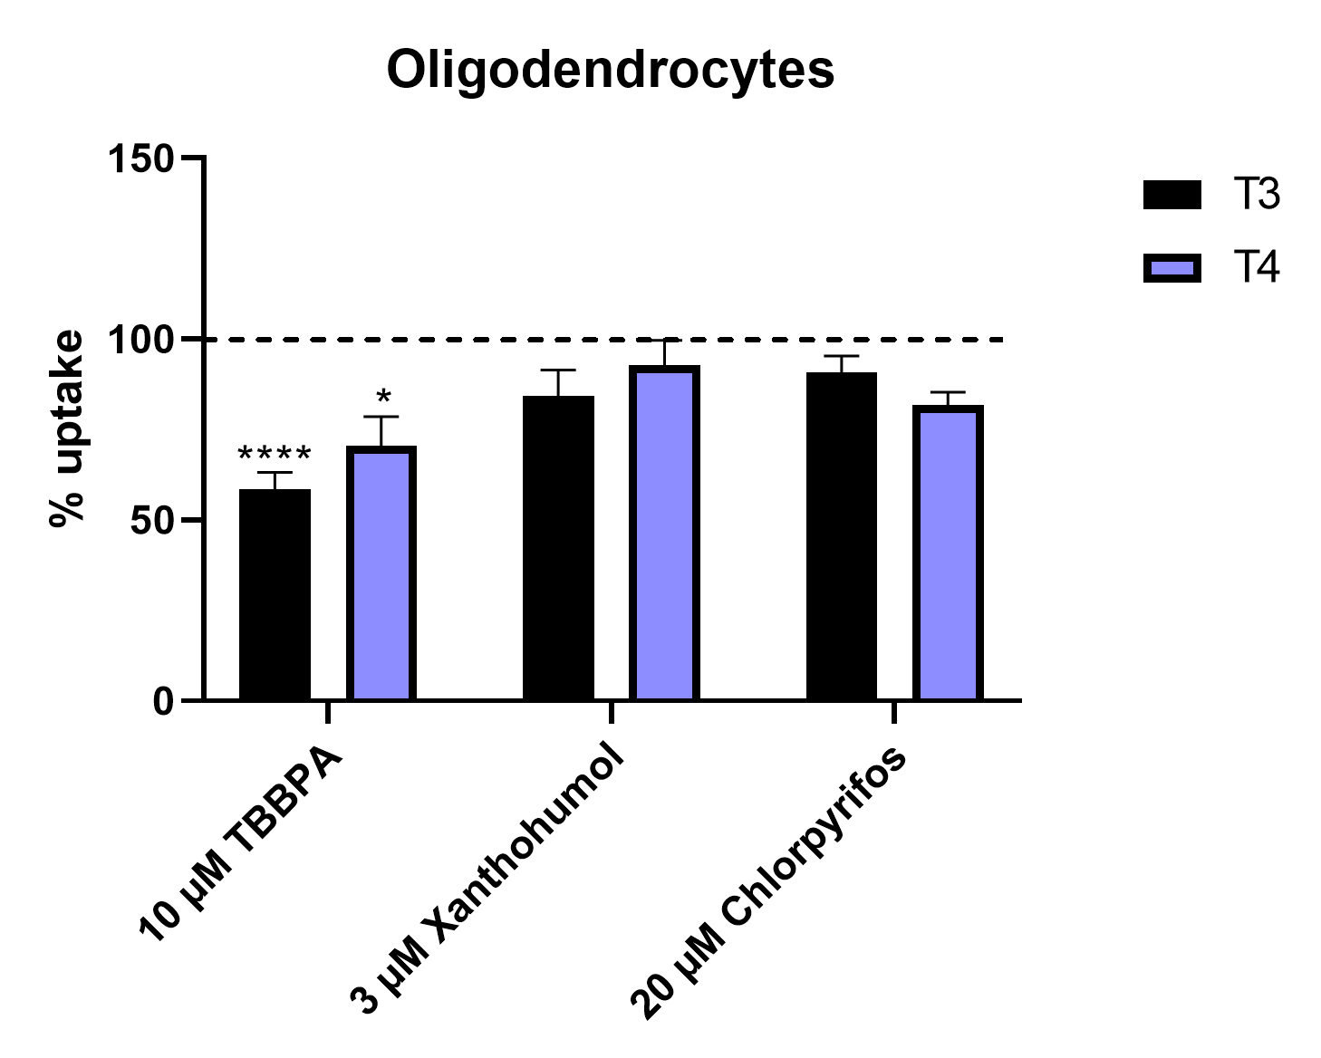
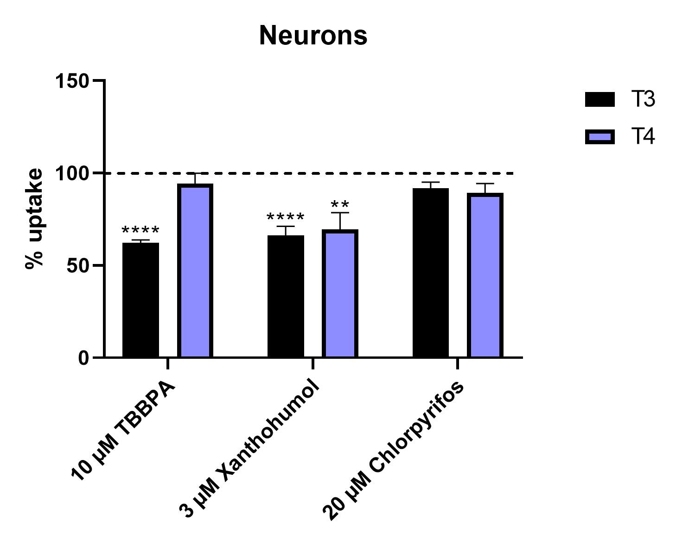
EDCs inhibit uptake of thyroid hormone
Multiple EDCs tested for inhibition of thyroid hormone uptake
Difference in inhibitory effects of EDCs between different cell types
*p<0.05, **p<0.01, ***p<0.001, ****p<0.0001

Slide 9
Regulation of TH in target cells
Aim: development of an in vitro testing battery for thyroid hormone mediated developmental neurotoxicity
Astrocytes
Neurons
Oligodendrocytes
TH transport
Deiodination
Receptor activation

Slide 10
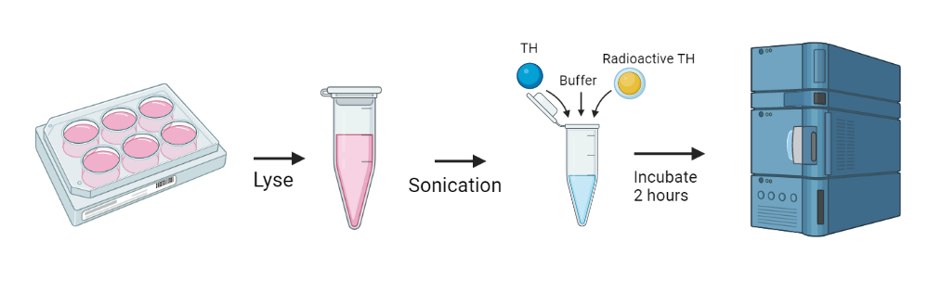

Deiodinase assay (in vitro)

Slide 11
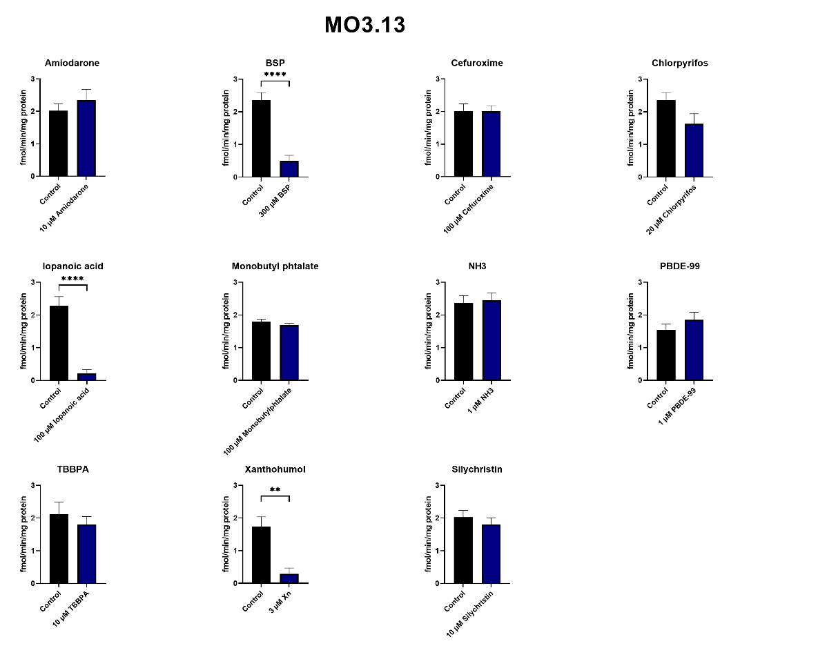
D3 inhibition MO3.13
N=2-3 (Mean ± SEM)

Slide 12
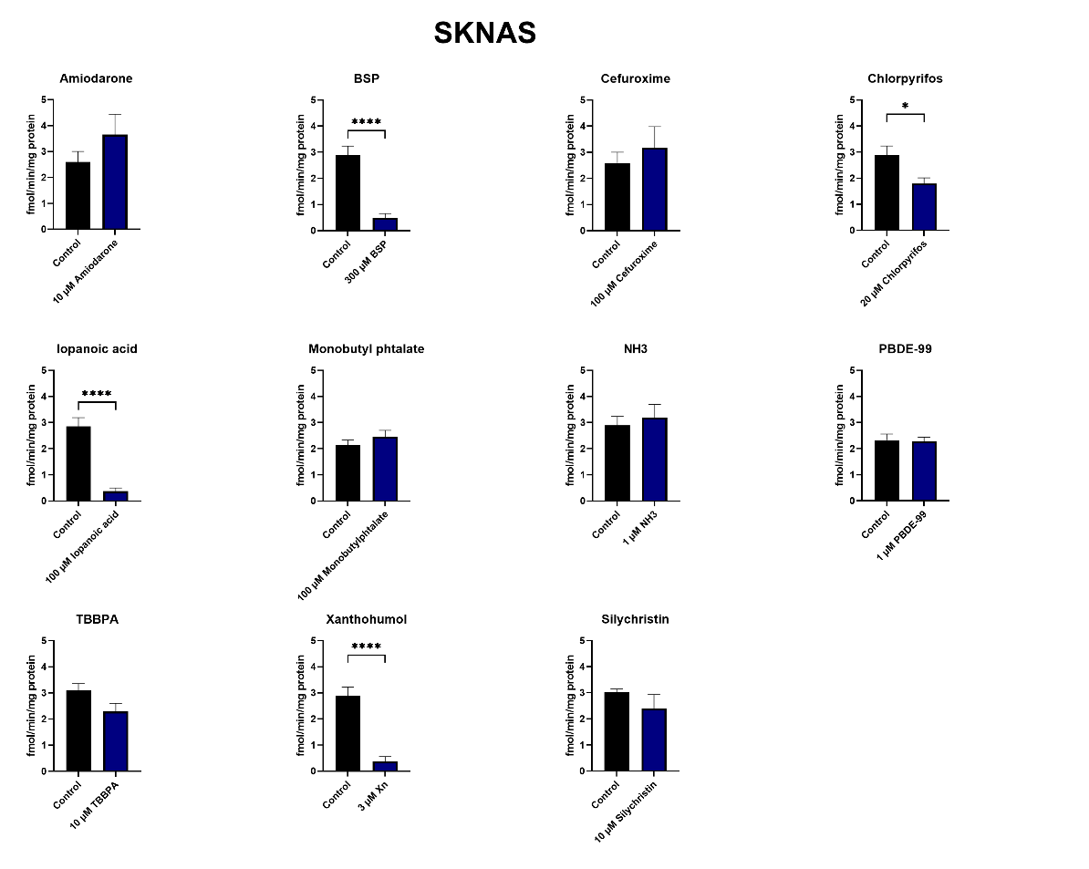
D3 inhibition SKNAS
N=2-3 (Mean ± SEM)

Slide 13
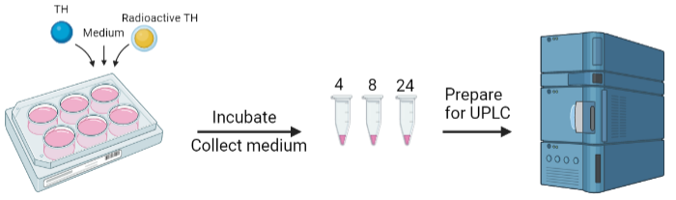
Metabolism assay (intact cells)

Slide 14
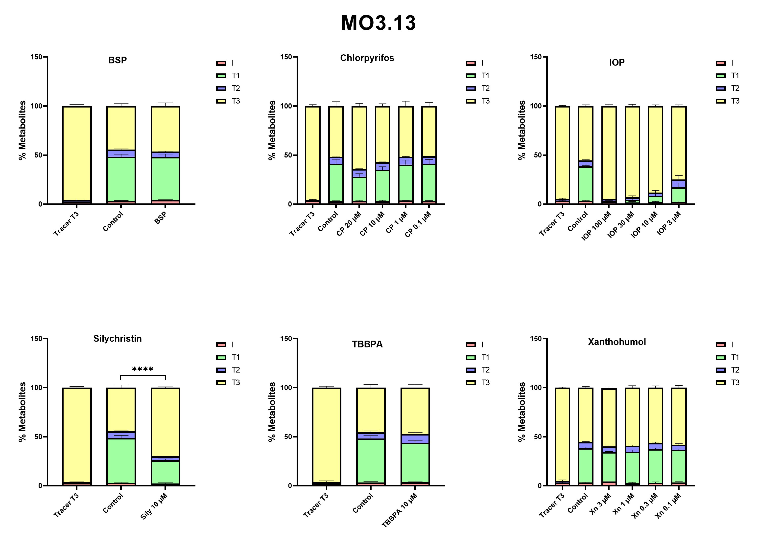
Metabolisme MO3.13
Samples genereren
Data analyse
Manuscript schrijven
Feedback en insturen

Slide 15
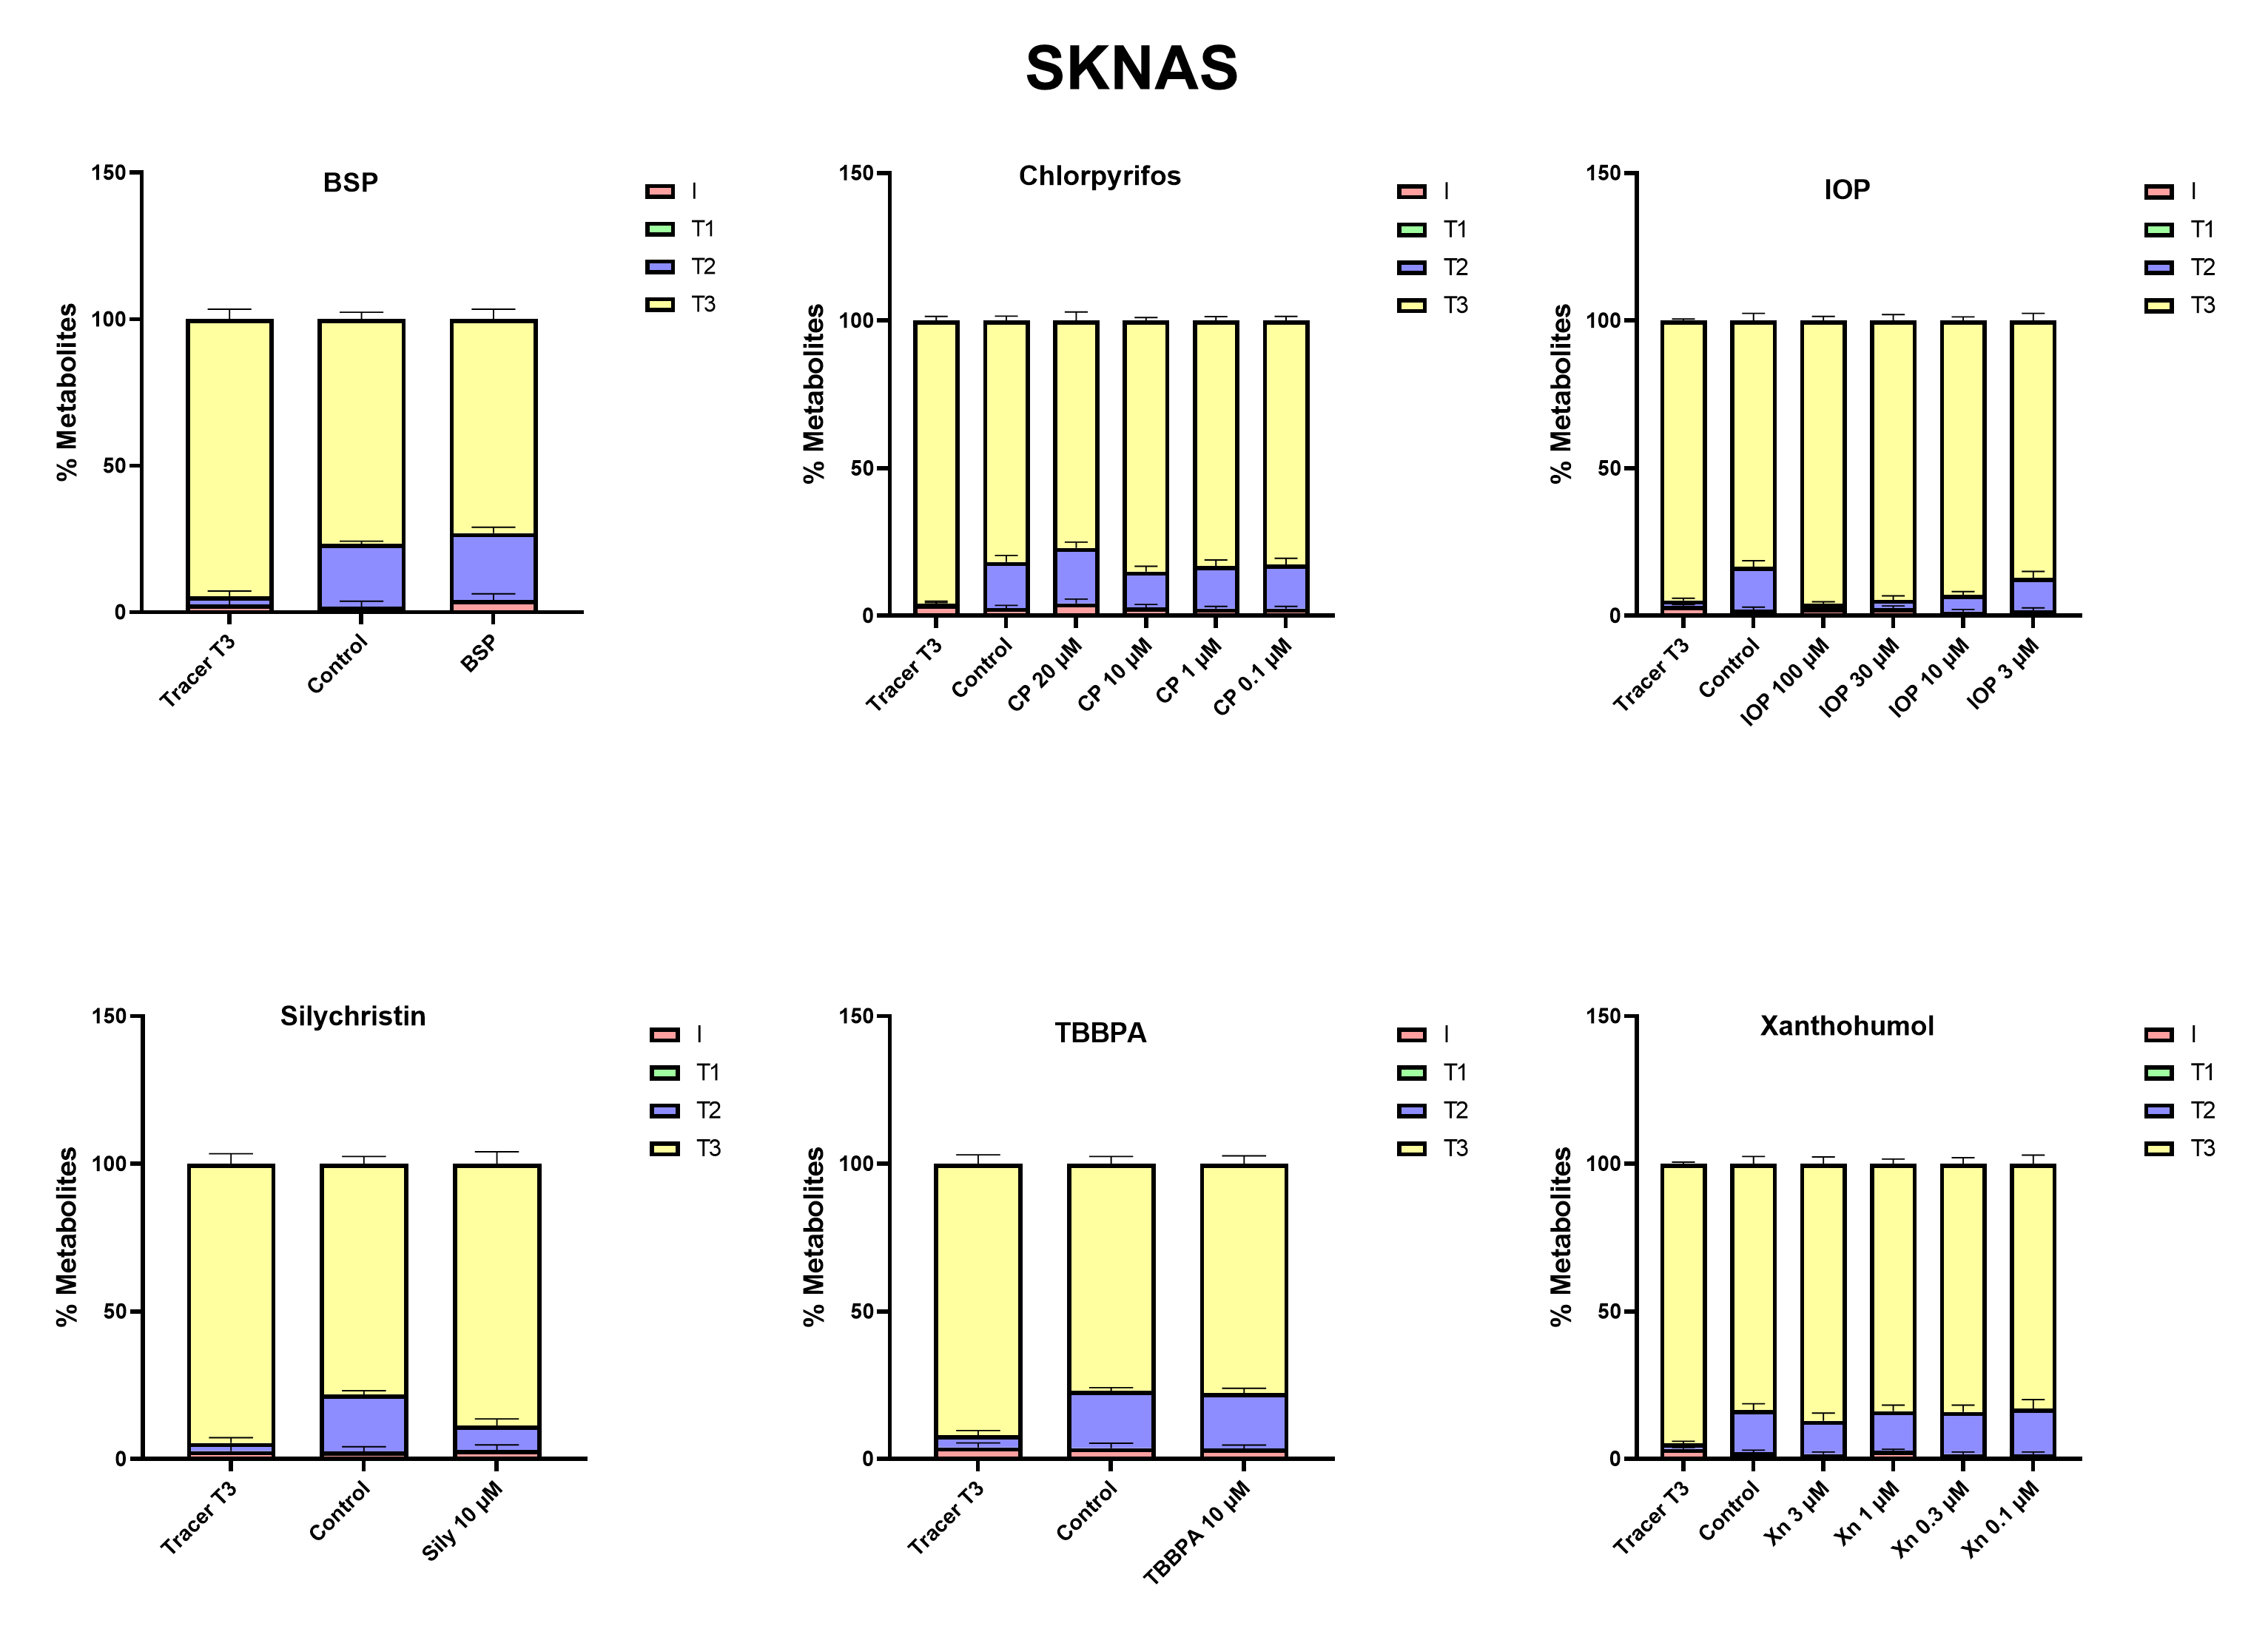
Metabolisme SKNAS
Samples genereren
Data analyse
Manuscript schrijven
Feedback en insturen

Slide 16
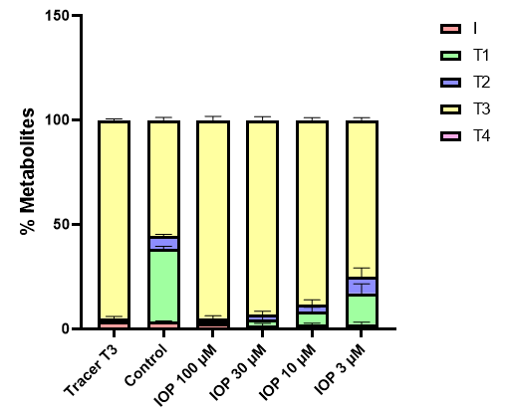
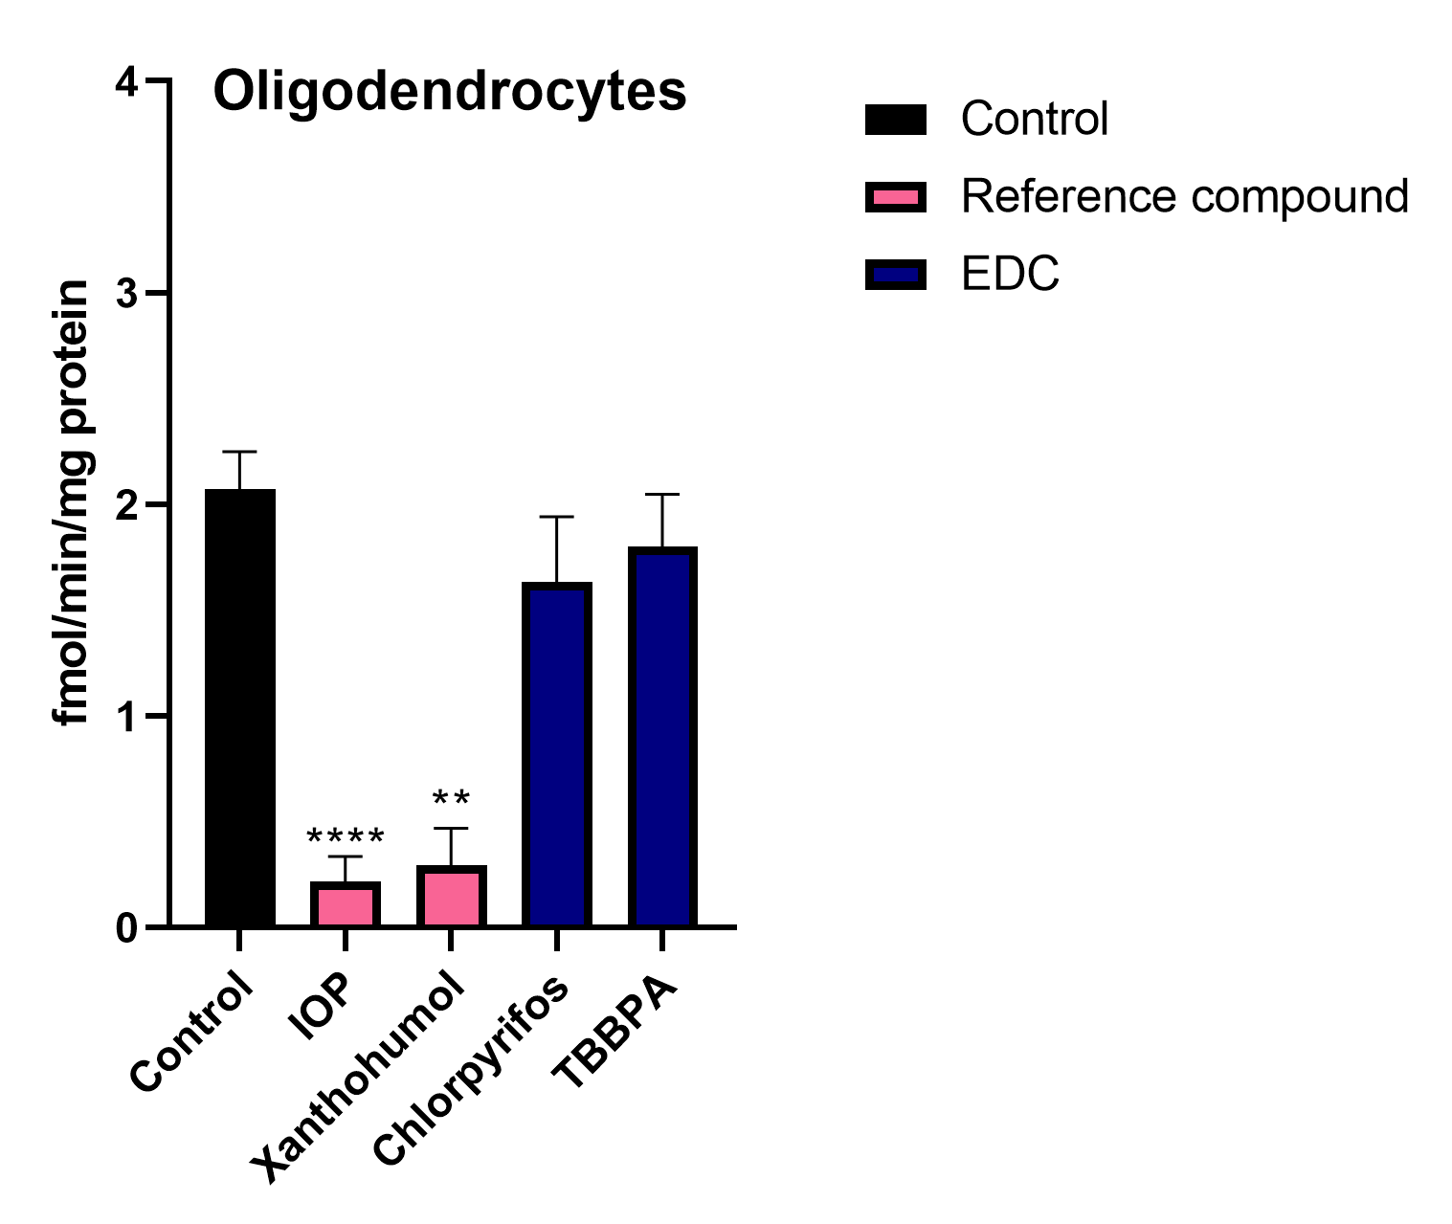
Whole-cell metabolism assay: oligodendrocyte example

Slide 17
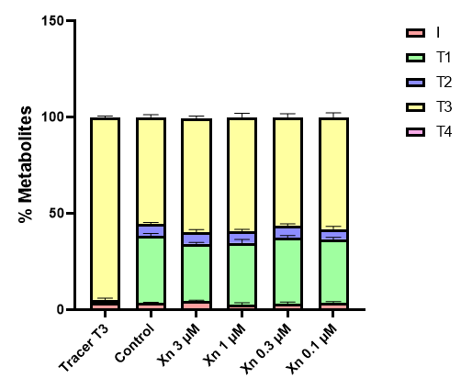
Whole-cell metabolism assay: oligodendrocyte example

Slide 18
Regulation of TH in target cells
Aim: development of an in vitro testing battery for thyroid hormone mediated developmental neurotoxicity
Astrocytes
Neurons
Oligodendrocytes
TH transport
Deiodination
Receptor activation

Slide 19

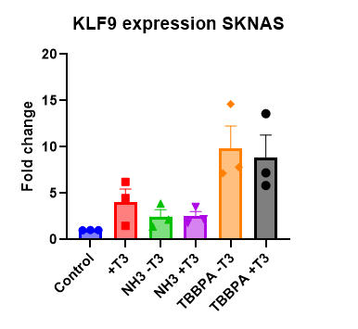
Receptor activation: KLF9 expression
Compound exposure with and without T3
NH3: synthetic thyroid hormone
receptor antagonist
TBPPA: seems to have an agonistic effect
N=3 (Mean ± SEM of biological replicates)

Slide 20
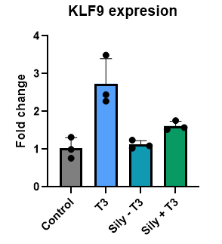
Receptor activation: Silychristin
Preliminary results: less induction of KLF9
In ‘silychristin + T3’ condition compared to
‘only T3’ condition
→ effect might be explained by the effect
of silychristin on TH transport inhibition
N=1 (Mean ± SD of technical replicates)

Slide 21
Conclusion
Chosen cell lines are suitable to measure inhibition of TH uptake
Deiodinases are present in corresponding cell types
Cell lysate assays (Deiodinase assay) lack a level of complexity, as shown by differences in outcome in the metabolism assay
Receptor activation for SKNAS cells can be measured via KLF9 expression

Slide 22
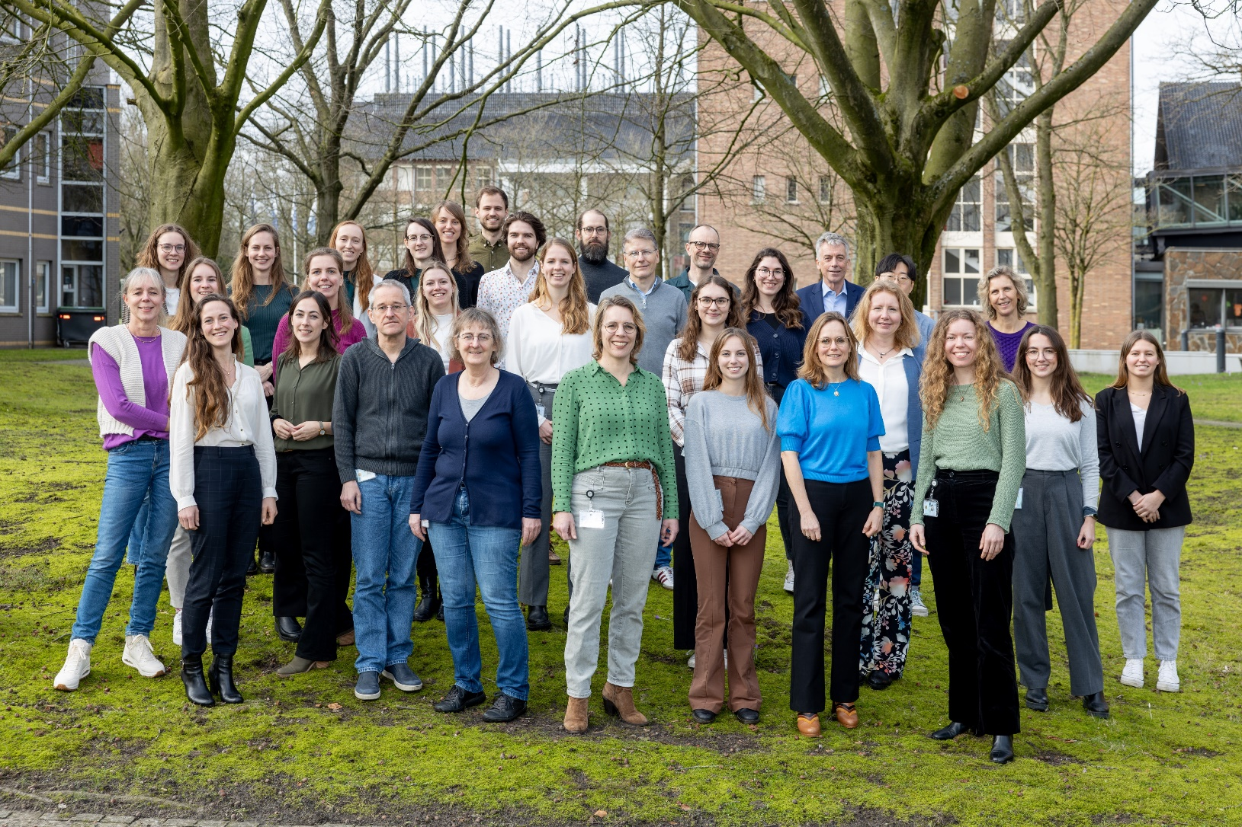

Acknowledgements
National institure for Public Health and the Environment (RIVM)
Erasmus MC Academic Centre for Thyroid Diseases
Edward Visser
Marcel Meima
Robin Peeters
Daniëlle Westerbeek
Max Tio
Aldert Piersma
Ellen Hessel

